Slide 1


Sharjah American International School
Abu Dhabi campus
2025-2026
Middle School Parent-Student Handbook

Slide 2
Handbook Overview
The purpose of the SAIS Abu Dhabi campus Parent-Student Handbook is to give students and their parents/guardians an understanding of school expectations and policies as well as provide pertinent information. The handbook includes detailed expectations for student attendance, behavior and discipline, including policies and consequences for bullying and harassment, due process rights related to discipline (including suspension, expulsion, and special education), and a description of both informal and formal complaint procedures that parents may pursue in the event of disagreements. SAIS Abu Dhabi annually updates the Parent-Student Handbook for distribution to families. Amendments to the handbook by SAIS may be made throughout the year.
Every student and his/her parent or guardian is required to sign and return an Acknowledgement Form at the beginning of each academic year establishing that they have read and understand the expectations and policies.

Slide 3
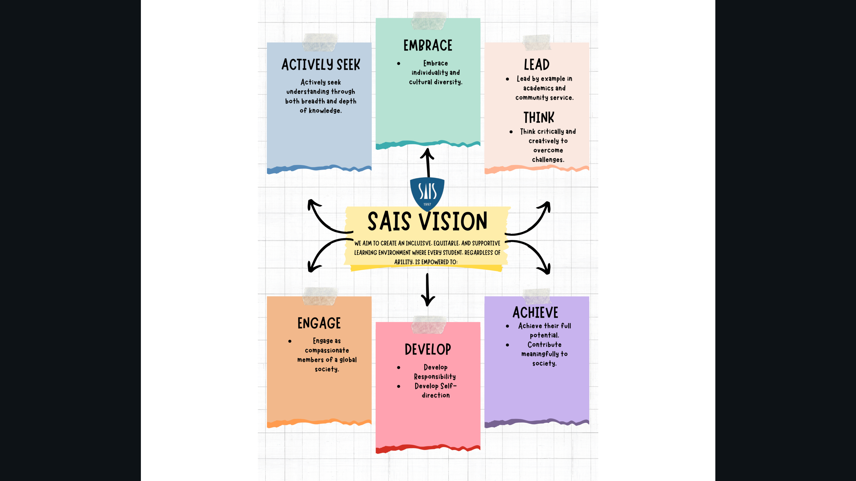
SAIS
Vision

Slide 4
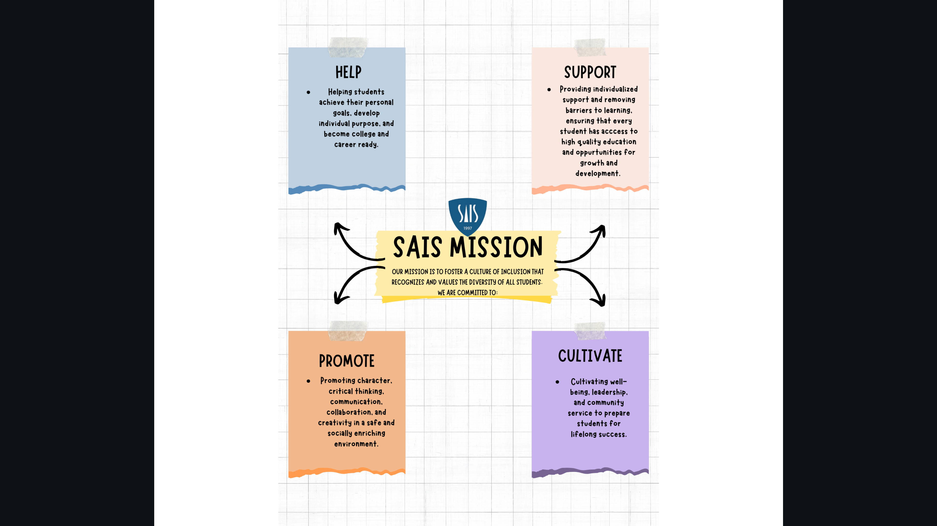
Sais
Mission

Slide 5
Values
S- Social responsibility
A-Acceptance,
I-Integrity
S-Self-confident

Slide 6

Academics
SAIS Abu Dhabi is committed to maintaining a relevant, rigorous college-preparatory education for all students.

Slide 7
International Academic Standards
The AERO (American Education Reaches Out) framework provides standards-based guidance for international schools following a U.S. curriculum. Developed with support from the U.S. State Department’s Office of Overseas Schools, it aligns with Common Core and Next Generation standards, ensuring consistency across subjects. AERO helps schools design curriculum, assessments, and professional development to maintain high-quality, transferable education for globally mobile students.
MOE Standards
The school follows the Ministry of Education (MOE) Curriculum for Arabic, Islamic, and UAE Social Studies. MOE curriculum is taught in Arabic. Islamic Studies is mandatory for all Muslim students. Alternative classes are offered for Non-Arab students and Non-Muslim students.

Slide 8

EAL Program and ALN Support Lessons

Slide 9

EAL Program
At SAIS-Abu Dhabi we utilize the WIDA screener as a benchmark to identify a student’s English proficiency skills in reading, writing, listening, and speaking. Utilizing this benchmark, we are able to identify students within the school who need additional foundational English support before they are able to function in the mainstream English class. Through the hard work of talented and highly qualified teachers, EAL students are provided support with our EAL Program which allows teachers to provide smaller teacher: student ratios and provide even further differentiated support to students to help them achieve proficiency in their English skills that will help them to achieve success in their mainstream classes.

Slide 10

ALN Support
At SAIS-AUH we are committed to fair and equal treatment of all individuals regardless of ability. No disabled student or staff member will be treated less favorably as a result of their disability. Both able and less able students will be provided with appropriate learning activities, learning environment and materials to meet their general education, in age-appropriate classrooms.
The school recognizes that “special considerations” may be required to enable students with disabilities or learning difficulties or who are gifted and talented to exhibit their capabilities and knowledge. Our Inclusion Coordinator is responsible for organizing extra support for pupils with ALN. The Inclusion Coordinator works with the class teachers and subject teachers to plan the help that each child needs.

Slide 11

Student Care and Support
SAIS-AUH is a school where learners feel at home. We believe that a safe learning environment contributes to student success and achievement. We lead our students to aim high by boosting their confidence. SAIS-AUH students are encouraged and appreciated for their achievements whether great or small. Our students take pride in their work and in themselves. SAIS-AUH Support Team seeks to create a school environment where students feel supported academically and emotionally. We make sure that all staff members are working to support the students with plans, activities, and appropriate follow-up to help them achieve success both inside and outside of the classroom. In addition to this we offer support for our students and staff about child protection, anti-bullying campaigns, health and wellness, etc. SAIS Support Team

Slide 12
Academic Integrity Policy
SAIS Abu Dhabi values real mastery of subject content and has adopted high standards for honesty. Prohibited activities include:
Cheating
Plagiarism
Any student determined to have cheated, plagiarized, or committed forgery will be subject to consequences which may include, but are not limited to the following:
Receive a zero grade on the assignment or test
Receive a failing grade for the class
Receive an opportunity to retake test or complete assignment honestly
Any student assisting in any of the above will also be subject to consequences. The instructor and administration will determine consequences based on the nature of the offense.

Slide 13
Cheating
Cheating on an assignment or test robs a student of any inherent value of the assignment or test. In addition, cheating may unfairly affect other students by changing a grading scale or curve.
The choice to cheat on an assignment or test may reflect more serious academic issues including fear of failure, an outside of school schedule that prevents the student from completing work, and/or incorrect class placement. Whatever the cause, students who engage in cheating compromise their integrity, dignity, and self-worth.
All assignments should be considered individual unless specifically stated by the instructor as otherwise. Cheating includes:
Exchanging assignments with other students, whether you believe the assignment will be copied or not.
Using any form of assistance during tests or quizzes without the expressed permission of the instructor.
Giving or receiving answers during tests or quizzes. It is the student’s responsibility to secure his or her own paper, thereby removing the opportunity for another to copy.
Taking credit for group work when you have not contributed an equal or appropriate share toward the end result.
Accessing a test or quiz to determine the questions prior to the administration of the test.

Slide 14
Plagiarism
The ability to present thoughts and ideas clearly and coherently in a written form is a cornerstone of academic success. Plagiarism prevents students from developing the skills necessary for academic competence. Additionally, it prevents the instructor from providing appropriate feedback and assessment to assist the student in correcting any deficiencies in his or her writing.
All assignments must be written in the student’s own words. Quotations, thoughts and ideas taken from another’s writing must be given appropriate credit in the paper.
Plagiarism includes:
  Taking someone else’s assignment, or portion of an assignment, and submitting it as your own
  Submitting material written by someone else, or rephrasing the ideas or thoughts of another, without giving the author’s name and/or source
  Presenting the work of someone else, including tutors, friends, parents, or siblings, as your own
  Submitting purchased papers, in whole or in part
  Submitting papers from the Internet as your own, in whole or in part

Slide 15
SAIS Abu Dhabi Grading Policies
Letter Grade | Percent Grade | 4.0 Scale
A+ | 97-100 | 4.0
A | 93-96 | 4.0
A- | 90-92 | 3.7
B+ | 87-89 | 3.3
B | 83-86 | 3.0
B- | 80-82 | 2.7
C+ | 77-79 | 2.3
C | 73-76 | 2.0
C- | 70-72 | 1.7
D+ | 67-69 | 1.3
D | 65-66 | 1.0
D- | Below 65 | 0.5
E/F | Below 60 | 0.0
AP/ IB courses | An addition of 0.25 to the standard weighting
Final Academic Grade
% Average | GPA | Comment
84-100% | 3.67-4.33 | Excellent
76-<84 | 2.67-3.66 | Good
68-<76 | 2.00-2.66 | Satisfactory
60-<68 | 1.67-1.99 | Poor

Slide 16
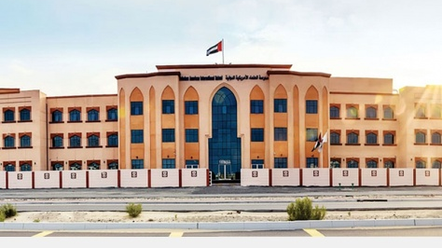
Middle School
SAIS-Abu Dhabi offers a safe, supportive, and challenging place to make the transition from elementary to the middle school level smooth and successful. Students find the guidance of caring teachers who appreciate this age group.
By offering a variety of electives, outdoor education, and service experiences, students learn to give voice to their opinions, questions, and personal passions. Project based learning reinforces the importance of cooperation and collective achievement, while interdisciplinary learning helps students make meaningful connections between coursework and real life, and helps foster understanding and concern for others.
Grade 5 and 6 students take part in a variety of electives such as French, Music, and Art. Our Grade 6 students also benefit from taking Health & Nutrition. Our Grade 7 students benefit by taking from taking Music, and Art. Our Grade 8 students partake in Personal Finance as well as Music and Art.
Subject/Course
English Language Arts
Math
Science
Grade 5-7 Social Studies; Grade 8 Geography
Physical Education
Electives : French, Music, Art, Personal Finance, Speech and Debate

Slide 17

Middle School Promotion and Retention
SAIS Abu Dhabi feels strongly that students should take ownership of their coursework. The following will serve as the guideline for repeating courses and/or a particular middle school grade level:
If two or more core classes (English, Science, History, and Math) are failed in a year, the student may be required to repeat the school year in the grade in which the courses were failed.
Math courses are sequential and integrated in nature. If a student fails one or two semesters of a middle school math course, they may be required to repeat that course and/or attend a support class the following year. Students may be required to give up their elective class to repeat the course. Successful completion of Math 8 is required to enroll in high school math coursework.

Slide 18


Middle School Awards
The Middle School strives to recognize our students’ accomplishments throughout the year. Academic awards are acknowledged during assemblies in a variety of ways.
S.T.E.A.M. PROGRAM
We challenge our students to investigate the wonders of the many scientific fields. Our collaborative approach to S.T.E.A.M. provides students with a unique opportunity to engage in Science, Art, Math, engineering and technology. We provide students with the tools to experiment with robotic technology while learning about construction and programming. We use Lego Mind Storm, SAM, PITSCO, PASCO Kits to help students understand the different branches of engineering and problem solving while incorporating mathematics and physics.

Slide 19

Health and Nutrition
This course is designed to support students in in this development phase of their lives. Students will cover concepts related to mental, emotional, and social health. They will also learn about injury prevention and safety as well as the ill effects of alcohol, tobacco, and drug uses.

Slide 20


Personal Finance
In this introductory finance course, students learn basic principles of economics and best practices for managing their own finances. Students learn core skills in creating budgets, developing long-term financial plans to meet their goals, and making responsible choices about income and expenses. They gain a deeper understanding of investments, stock markets, and other systems so they can better understand their role in the economy of society. Students are inspired by experiences of finance professionals and stories of everyday people and the choices they make to manage their money.
Shark Tank
This course is designed to expose students as young entrepreneurs. Students will have the opportunity to pick pre-existing issues in the world, through their previous knowledge they will create their own product/service. Real-world entrepreneurs and business experts from inside and outside UAE will serve as mentors and coaches to guide the teams through the process of ideation, scientific research, and business plan development. Over the course of the year, students will work in a team to make their idea come to life and then pitch their idea to a group of judges that is composed of different professionals from different fields – similar to the concept of “Shark Tank”.

Slide 21

Middle School Sample Timetable

Slide 22

Course Changes
Students and their parents are encouraged to carefully select classes in the Spring for the following school year. We realize that academic plans and goals change and therefore, students may need to make course adjustments. However, we also recognize the need for continuity in classroom instruction. In trying to balance the two issues, the following course change procedure will be in effect.
Student or parent-initiated course change requests will only be considered during the first two weeks of the new term. After this time, course changes will only be made to address academic concerns.
Course changes will only be made for academic or medical reasons. Requests to be placed in different courses based on personal preference (i.e. being with a friend), will not be honored.
In general, courses at SAIS Abu Dhabi are considered to be yearlong in nature. As a result, approval for term 2 or term 3 changes will only be considered for the purpose of addressing academic or medical concerns.
Please see the School Counselor for information on making up necessary courses.
Transfer Students
When a student comes in after the fourth week of a term, it becomes increasingly difficult for a teacher to adequately assess learning. Students who transfer in after four weeks should either have a transfer grade from the previous school or be aware that makeup work will be at the discretion of the teacher.

Slide 23

Assessments
Assessments- Internal
Students from G5-G8 take internal assessments throughout each term including but not limited to: diagnostic pretests, ongoing assessments, midterm exams, and final exams. These assessments are used to track student attainment of curriculum goals across a wide range of subjects. Students receive study guides at least two-three weeks prior to these assessments so they have plenty of time to prepare. The results of the internal assessments provided detailed information to teachers about student learning targets met each term. This information also helps teachers revise the curriculum in the next term to meet individual student needs and goals.
Assessments- External
NWEA Map Testing-
Here at SAIS- Abu Dhabi, our students in G6-G9 take the Map test during three windows throughout the course of the academic school year. Map assessments are computer adaptive and produce accurate, reliable data that reveal the precise learning level of every student, regardless of the student's ability or grade level. Map identifies areas of strength and opportunity at the goal level of a subject, as well as overall performance.
CAT 4 Testing-
The Cognitive Abilities Test (CAT4) is a diagnostic assessment that is designed to help students and their teachers understand how they learn and what their academic potential might be. It assesses how students think in areas that are known to make a difference to learning. Our students in G6-G12 take the CAT 4 test once upon joining the school so we can identify their learning styles and incorporate that into differentiated instruction within the classroom.
IBT Arabic Testing-
To meet the expected standards of attainment of Arabic Language Proficiency, our school participates in taking the IBT Arabic exam conducted by ACER. The IBT Arabic assessment is designed to give an international benchmark of your child’s performance vs. other participating countries in the region and around the world.

Slide 24
SAIS Code of Conduct Policy
2025-2026

Slide 25
Responsibilities:
Managerial Responsibility:
The school management is responsible for ensuring that our learning environment is completely safe and discipline that includes rules, ways of encouraging and affirming student efforts, rewards, penalties’, and implementation procedures.
Ensure through regular review of the behavior policy, involve students, parents, teachers and other staff that the behavior policy is understood and accepted by all members of the school community.
Establish the school pastoral Committee.
Develop, implement and regularly review the School’s policies and procedures for promoting good attendance, and follow up on excessive absence including truancy, and ensure full compliance with the Council’s requirements.
Ensure that the School’s attendance policies and procedures are implemented and adhered to.
Ensure effective administration of student attendance and recording daily attendance at all lessons.
Provide clear information about the consequences of poor attendance to Parents/Guardians, students and School staff. - Set procedures for dealing with poor attendance and tardiness.
Recognize students with exemplary attendance records.

Slide 26
Responsibilities:
Teachers Responsibility:
Staff will take every opportunity to raise students’ awareness and understanding of the many issues related to behavior and discipline through effective use of HALP, Student Government , Islamic Education and Moral Education,
School staff should consider themselves responsible at all times for the behavior of students within sight or sound of them and should respond promptly and firmly to any instances of unacceptable behavior.
Exert efforts to establish the motivation behind and the purpose of the student’s misconduct ,in order to respond to it with suitable solution ,rather than simply taking a punitive approach.

Slide 27
Responsibilities:
Parental Responsibility &
Student Responsibility Attitudes and Behavior
Parent responsibility:
Parents should provide a conducive home environment as it plays a crucial role in shaping attitudes that produce good behavior in schools. It is therefore important that parents should be aware of the aims, values and the nature of expected behavior of the school.
Student Responsibility Attitudes and Behavior:
SAIS students are expected to demonstrate high standards of behavior at all times .This includes moving around the school, in tutor time and assembly, in the social areas and on the way to and from school.
Appropriate action will be taken by the school against any students whose behavior is unacceptable and undermines the good discipline or reputation of the school.
The cornerstones of standards of students’ behavior are respect for oneself, respect for others, respect for the school and local community, and respect for the environment.

Slide 28
Responsibilities:
SAIS Monitoring and Support Team:
SAIS-AUH is a school where learners feel at home. We believe that a safe learning environment contributes to student success and achievement. We lead our students to aim high by boosting their confidence. SAIS-AUH students are encouraged and appreciated for their achievements whether great or small. Our students take pride in their work and in themselves. SAIS-AUH Support Team seeks to create a school environment where students feel supported academically and emotionally. We make sure that all staff members are working to support the students with plans, activities, and appropriate follow-up to help them achieve success both inside and outside of the classroom. In addition to this, we offer support for our students and staff about child protection, anti-bullying campaigns, health and wellness, etc.

Slide 29

Responsibilities:
Attendance:
DEFINITION(S):
For the purposes of this policy, attendance refers to the total number of school days attended by the student during the school year based on the School calendar.
PURPOSE(S):
To ensure that students are attending all classes and activities that result in their understanding of the curriculum and the subjects being taught. - To set out the Council’s expectations in relation to full attendance at School by all students without exception, through a clear policy and effective communication with Parents/ Guardians. POLICY: At the beginning of the academic year, each School shall issue to Parents / Guardians its Council-approved attendance policy setting out procedures to deal with absences and to ensure that students punctually and regularly attend School and all lessons, and that all attendance data is accurately recorded.
Basic requirements and responsibilities in relation to students’ attendance at School are as follows and reflected in the School’s attendance policy:
• Students are expected to attend School on every school day as specified in the School calendar.
• Students shall arrive at School punctually every day, attend morning assembly, and attend classes on time.
• Teachers shall maintain a record of attendance by students for every lesson.
• Schools will maintain accurate daily attendance data for each student, including timely or late arrival to School.
• Parents / Guardians will make every effort to ensure that their children attend School every school day and arrive on time.
• If students need to be absent from School for a particular day, Parents/Guardians must inform the school accordingly.
• When a student returns to school following an absence, Parents/Guardians must send a signed note to the School indicating the reason for the student’s absence.
• Students are responsible for completing all assignments missed during their absence.
• Parents/Guardians should seek to ensure that family vacations take place during scheduled school holidays.

Slide 30
Responsibilities:
Absence:
DEFINITION(S):
For the purposes of this policy, absence refers to the days when students fail to attend School. A student who does not miss a single class throughout the year is said to have a 0% absence record or a 100% attendance record. Absence rates above 10% should be regarded as a cause for concern. Authorized absences are to be distinguished from unauthorized absences or truancy.
PURPOSE(S):
To encourage students to attend all classes in a timely manner, so that they maximize the educational benefit of being in School.
To ensure that unauthorized absences are dealt with firmly and effectively.
This policy is linked to attendance policy, which highlights the need for students to punctually and regularly attend School and all lessons. Schools shall seek to achieve low absence rates by:
Following up on all unexplained absences immediately.
Providing a safe, caring and engaging learning environment that encourages and stimulates students.
Recognizing and rewarding excellent or improved student attendance.
Implementing strategies and programs to address attendance problems for individual students.
Providing clear and specific information about the rules and consequences of poor attendance to Parents/Guardians, students and School staff.

Slide 31
Responsibilities:
Absence:
Types of Absences Authorized Absences The following types of absences may be regarded as authorized when confirmed by a signed letter from Parents/Guardians or by way of official documents:
Illness.
Death of first or second degree relative.
Scheduled doctor appointments.
Official community task.
Mandatory appearance before an official body.
Essential urgent family travel for matters such as medical treatment or the death of a family member.
Unauthorized Absences The following types of absences are to be regarded as unauthorized:
Shopping trips.
Unnecessary travel.
Other types of absences not included in the authorized absences list.
Students are considered to be truant if they are absent from School without their Parents’/Guardians’ knowledge or consent, or if Parents/Guardians have colluded with the student so that they are absent without authorization. Truancy is an unauthorized absence, and Schools must immediately inform the student’s Parents/Guardians of incidents of truancy and shall hold discussions with them and the student and closely monitor the student’s attendance. If an absence is authorized, the student has the right to make up the work and tests that were missed. If an absence is unauthorized, the School will agree with the Parents/Guardians on the appropriate course of action pending completion of the investigation into the circumstances surrounding the absence. School administration will excuse students for being late in the morning during days with adverse weather conditions (e.g. heavy fog). Parents/Guardians who plan to have their children miss several days of School are required to notify the School at least ten days before the anticipated absence, in order to allow teachers time to prepare the list of assignments that will be missed during the absence. The student or Parent/Guardian shall be responsible for contacting the School administration to learn of all assignments and tasks given to the student. These assignments must be completed by the student and returned to the relevant teachers either before leaving or shortly after returning from the absence.
If students have poor attendance rate of 10% or more the school will take follow up actions with parents and notify ADEK.

Slide 32
Responsibilities:
Motivation:
Here at SAIS AUH we believe that motivation has several effects on students' learning and behavior and that this effect their learning and achievements. we use a variety of motivational tools to encourage students academic and personal development , examples include the use of Class Prefects, the merit system along with the implementation of houses from KG to G12 to encourage healthy competition. We also have star of the week, students of the week and class of the month in the MS/HS section. Students are rewarded with gift cards and certificates, pizza parties, trips with recognition for their achievements.

Slide 33

A. The SAIS Code of Conduct:
It is the right of every individual and groups at SAIS to feel safe and to have a peaceful, dignified existence, without being hindered by the behavior, attitude or noise level of others. In order that this may happen, it is essential that every member of the school community is:
Considerate - respecting other individuals’ right to a peaceful, dignified existence; making sure that words and actions do not cause inconvenience or offence to others;
Courteous – being polite and helpful at all times;
Co-operative – being willing to work with others;
Friendly – being on good terms with others;
Hardworking – doing our best;
Honest – being truthful; respecting the property of other people;
Respectful – of the culture, values and traditions of others;
Responsible – being accountable, reliable and responsible for our actions.
What this means in practice is that I should:
Be Punctual – always arrive to school & class on time;
Speak Considerately – avoid shouting, swearing and offensive language;
Be Ready for lessons – have the necessary materials;
Clear Up – after lessons and break, use the rubbish bins;
Be Safe and Sensible - move in an orderly way – avoid running and use paths; hold doors open for other people; be aware of our own & others’ safety;
Negotiate – if I know there might be a problem, go and talk about it to someone;
Respect – for authority, property and the rights of others.

Slide 34
B. SAIS staff members are committed to:
Maintaining a caring school environment which fosters self-esteem, where young people are accepted, respected and listened to.
Being alert and responding to signs of distress or suspected incidents of harassment and bullying in class and at play areas.
Providing appropriate counseling & support to both those being bullied & bullies.
Modeling appropriate behavior.
Ensuring that supervision duties are carried out proactively & responsibly to ensure student safety.
Following-up all reported cases of bullying or harassment.
C. SAIS Stepped Approach to Behavior Management
As per UAE law & SAIS policy, corporal (physical) punishment & humiliation are strictly prohibited. Any teacher using physical punishment (including putting in the sun as a punishment, hitting, slapping, pinching, pushing, dragging, denying water or toilet trips (when it is necessary and urgent) , name-calling, swearing, insulting etc) will be disciplined.

Slide 35
Conduct violations

Slide 36

Conduct Violations (1)
1.1 Being late to the morning assembly or not attending it, being late to class at the specified time without an acceptable excuse.(School time 7:45 HALP time, first period 8:00 )
1.2 Leaving the class during the lesson or not attending school activities without
permission or acceptable excuse
1.3 Not committed to school or sport uniform or not taking care of it.
1.4 Not bringing school books or tools.
1.5 Not following the positive behavior rules inside and outside the classroom such as:
listening during the lesson
1.6 Sleeping during the lesson without permission or acceptable excuse. (After
checking the student’s health condition)
1.7 Eating during the lesson or the morning assembly without permission or an
acceptable excuse. (After checking the student’s health condition)
1.8 Does not submit the homework on time.
1.9 Bringing communications devices, such as mobile phones
1.10 Misusing the electronic devices, such as iPads, during the lesson, like playing games
or putting on headsets.
1.11 All similar offences according to the report of the Educational Committee.

Slide 37
Procedures to deal with the violation
First time | First repetition | Second repetition | Third repetition
Verbal warning | 1. Opening file and documenting the violation. 2. Informing the guardian in writing. | 1. Deducting half of the mark. 2. Calling the guardian for a meeting. 3. Written warning to be signed by the guardian. | 1. Call the guardian for a meeting. 2. Final written warning for the student and guardian in case of no response. 3. Deduct the whole violation’s mark. 4. Case Study by the Social worker. 5. Implement special strategies to reduce negative behavior 6--Transfer the case to second level violations.

Slide 38
Conduct Violations (2)
2.1 Repetition of any of the first level violations
2.2 Absence before and after holidays, vacations and weekend or before the final exams.
2.3 leaving the without permission or escaping during school day and that will be considered as absence.
2.4 Incitement of conflict or intimidation against school colleagues.
2.5 Acting against public morals, school rules and society values and habits, such as: Imitating the other gender through clothing, appearance and hairstyles and using cosmetics.
2.6 Writing on school walls, desks, furniture and school bus.
2.7 Photographing, possessing, publishing or circulating photos of school staff and students without permission.
2.8 Verbal abuse.
2.9 Smoking inside the school or the possession of smoking tools.
2.10 Vandalizing and damaging school buses and harming road users.
2.11 All similar offences according to the report of the Educational Committee.

Slide 39
Procedures to deal with the violation
First time | First repetition | Second repetition | Third repetition
1. Calling the guardian for a meeting. 2. Undertaking by the guardian and the student not to repeat the violation. 3. Deducting half of the violation mark. | Deducting the whole violation mark. Warning letter to be signed by the guardian and the student, or putting students in detention room from one to three days. | 1. Putting students in detention room from one to three days with homework and classwork. 2. Final warning | Transferring the student to another section. 2-Case Study by the Social worker and Transfer the case to Educational Committee to implement procedures to reduce negative behavior. Transfer the case to third level violations.

Slide 40
Conduct Violations (3)
3.1 Repetition of any of the second level violations.
3.2 Bringing, possessing, showing or promoting any unlicensed material or media against community values, morals and public regulations.
3.3 Defamation of colleagues and school staff and abusing them.
3.4 Possessing of white weapons inside the school.
3.5 Sexual harassment inside the school.
3.6 Physical abuse against school staff and students (bullying).
3.7 Stealing or covering it up.
3.8 Destruction and damaging school equipment, devices, tools and facilities.
3.9 Offending religions or inciting sedition in the school.
3.10 All similar offences according to the report of the educational committee.

Slide 41
Procedures to deal with the violation
First time | First repetition | Second repetition | Third repetition
1. Meeting the Educational Committee to make a decision. 2. Calling the guardian for meeting to sign the final decision. 3. Deducting whole violation mark | Consideration the case by the educational committee to decide the dismissal. Dismissing the students for one to two weeks. Deducting whole violation mark. | Issuing a decision by the Educational Committee to expel the students. Notify the guardian to transfer the student to another school. Incase of no responses, the student will be transfereed by order of the vice principal. | 1. Transfer the case 4 level violation 2. Final dismissal from school based on the decision of the deputy minister of academic affairs of public education. 3. Refer the student to specialized centers for behavior modification. 4.Consider students re- registration after referring the case to MOE.

Slide 42
Conduct Violations (4)
4.1 Repetition of any of the third level violations.
4.2 Bringing or possessing weapons inside the school, such as Firearms,
white weapons or any dangerous tools.
4.3 Sexual assault inside the school
4.4 Physical assault which cause injuries to school staff or to the students.
4.5 Leaking the exams or helping in that.
4.6 Causing fire inside the school campus.
4.7 Impersonating others in school processes or forging school formal
Documents
4.8 Offending political, religious, and social personalities
4.9 Possessing, using, or being under the effect of drugs or any similar
substances.
4.10 Promoting or spreading for extremist (to accuse others of being
out of Islam), or atheist beliefs that contradict the political, religious,
or social community regulations
4.11 All similar offences according to the report of the Educational
Committee.

Slide 43
Procedures to deal with the violation
Calling the guardian for a meeting. Referring the case to authorities to take legal action. Convening of the educational committee to make a decision and to inform the Legal Affairs department to make necessary action. Dismiss the student until the investigation is finished. The student and his guardian will be held accountable for consequences. Refer the student to specialized centers for behavior modification by the order of deputy minister for academic affairs. Blocking student’s registration in any public schools and transferring him/her to continuous education. Final dismissal for the student in case all methods are exhausted.

Slide 44

Bullying
Bullying is totally unacceptable and is not tolerated at SAIS. All SAIS family members are treated with respect, regardless of their gender, religion, appearance, race, and ability, ethnic or social background.

Slide 45

What is Bullying?
Bullying occurs when a person or a group of persons deliberately and repeatedly hurt, upset or frighten somebody less powerful than themselves.
Bullying includes:
Name calling, teasing, ridiculing, sarcasm
Putting down others and their achievements
Touching people in ways they don't want to
be touched
Damaging, stealing, removing or hiding
others’ belongings
Making comments/gestures to another of a
sexual nature
Making negative comments about family,
country of birth, nationality, ability or
religion
Making inappropriate comments about
another's physical appearance or clothes
Physical violence or threats
Forcing others to act against their will
Spreading rumors/gossip
Demands for money or possessions
Purposely leaving someone out of activities
Glaring and menacing gestures
Telephone/Cyber bullying
Writing offensive notes or graffiti, email
about others

Slide 46
There are no Acceptable Excuses for Bullying:
"I WAS JUST PLAYING AROUND. CAN'T THEY TAKE A JOKE?"
This is the most common response to bullying. It is not a joke to make someone feel miserable. This is bullying.
"I'LL IGNORE IT AND IT WILL GO AWAY"
If anything, ignoring it makes it worse. It gives the bully the impression that their bullying is OK and that you agree with what the bully is doing.
"ONLY WEAK PEOPLE TELL TALES"
It takes courage and strength of character to stand up for your rights and those of others. Bullying continues when people do nothing.
"I DON'T WANT TO CAUSE TROUBLE"
All members of the SAIS family have the right to feel safe at school. You are not causing trouble by telling someone about bullying; you are standing up for yourself and others’ rights.
"NO ONE CAN DO ANYTHING ABOUT IT"
Most cases of bullying are sorted out very simply, especially if it is reported straight away. We are committed to solving these problems.
"THEY ASKED FOR IT"
Nobody asks for it or deserves it.

Slide 47

Makeup Work
  Students are responsible for work missed while absent.
  The teacher can assist the student in obtaining a list of class assignments that need to be completed in a timely manner.
  Students who are absent should be proactive in finding out from their teacher(s) what was missed during their absences from school.
  Generally speaking, there is one day granted for each day of an excused absence in order to turn in the makeup work in a timely fashion.
  Please discuss make up work options with your teachers.
Student Attendance Review Team
Irregular attendance including but not limited to excessive early sign outs, tardies and/or absences are grounds for referral to the Student Attendance Review Team (SART). A maximum of twelve (12) absences per year (both excused and unexcused) are allowed. Any more than twelve (12) absences per year will be deemed excessive and grounds for Administrative Review.

Slide 48
Additional information

Slide 49

Personal Property, Mobile Phones and Devices
Personal Property
Students who bring personal property onto campus do so at their own risk. SAIS will not be held liable for lost, damaged or stolen items.
Mobile Phones
Mobile phones must not be seen after students enter the building in the morning, up until they leave in the afternoon. Mobile phones that are heard and/or used without permission during school hours will be confiscated and sent to the Boys & Girls School Supervisor Offices. If mobile phones are permitted to be used for educational purposes, the teacher/supervisor will communicate this with their students.
Bring Your Own Device (B.Y.O.D.) Grades 5-8
At SAIS we encourage students to engage with the curriculum and utilize 21st century skills to support their learning both inside and outside of the classroom. With this in mind, students are requested to bring their own devices to school when their class is assigned device time. Devices will only be used to support student engagement with such classroom tools like Canva, Google Classroom, Kahoot, Blooket, Quizziz, Virtual Labs, etc. Students are expected to use their devices only when instructed by their teachers and to maintain proper usage following the school Code of Conduct policy and Cyber Bullying laws.

Slide 50

Computer Use, Extra Curriculars
Computer Use:
In order to facilitate academic research endeavors, SAIS AUH provides restricted internet access. While the benefits gained from this service are clearly enormous, there is a potential for abuse. In order to continue this service, we ask that all students, staff and visitors sign an “Internet User Policy” wherein they agree to access only academically appropriate programs, material and content. Failure to abide by this agreement may lead to disciplinary action.
Extracurricular Activities:
Each term students are offered various opportunities afterschool that will encourage their growth in the arts, revision classes, and/or sports. Students will also be afforded numerous opportunities to take part in programs that encourage leadership and teamwork such as Model UN (Model United Nations and Model Congress and similar programs.

Slide 51


